Slide 1







































CUSTOMER FEEDBACK

Slide 2






Objectives
Check if customers are happy with our products and services.
Find out what we can do better.
See if customers will stay with us and recommend us to others.
Key Survey Questions
Are you satisfied with our product/service?
Was your issue resolved quickly?
Would you recommend us to others?

Slide 3

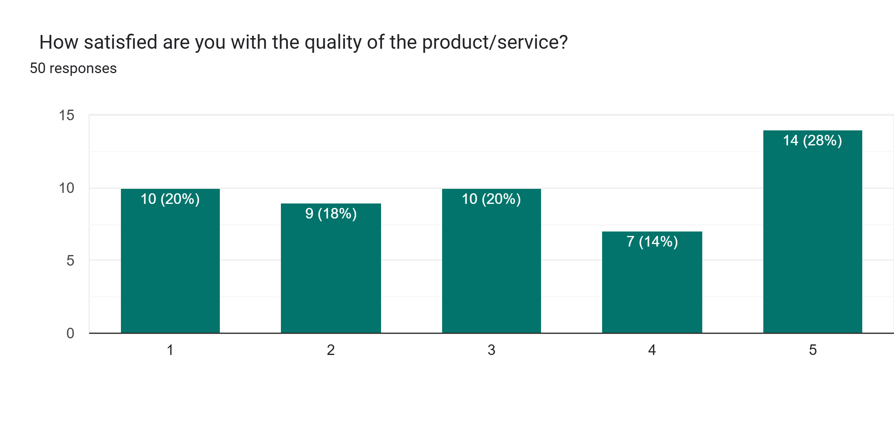
Survey Results

Slide 4
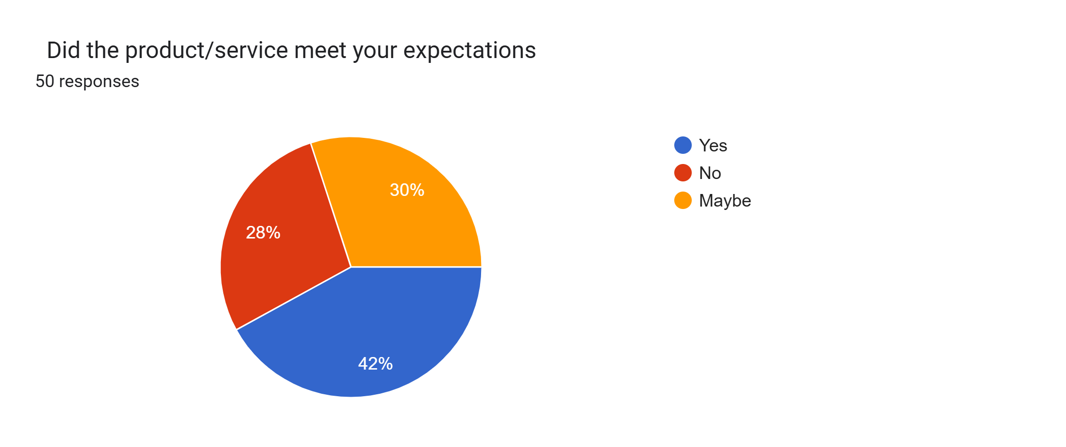
Survey Results

Slide 5
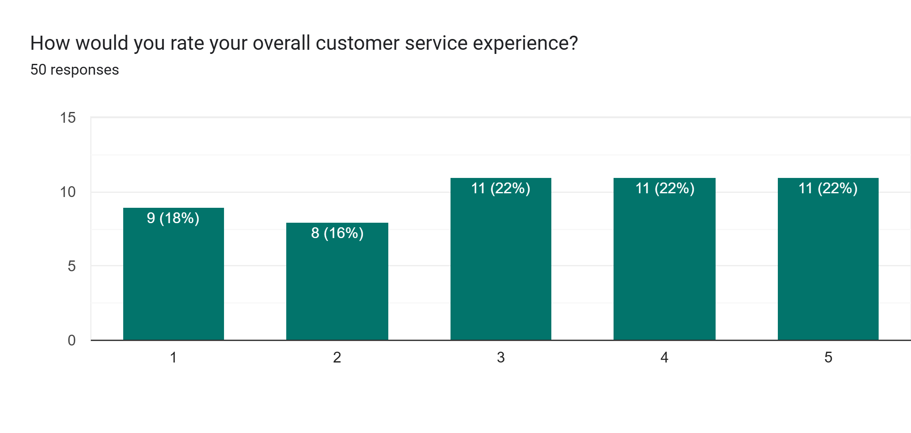
Survey Results

Slide 6
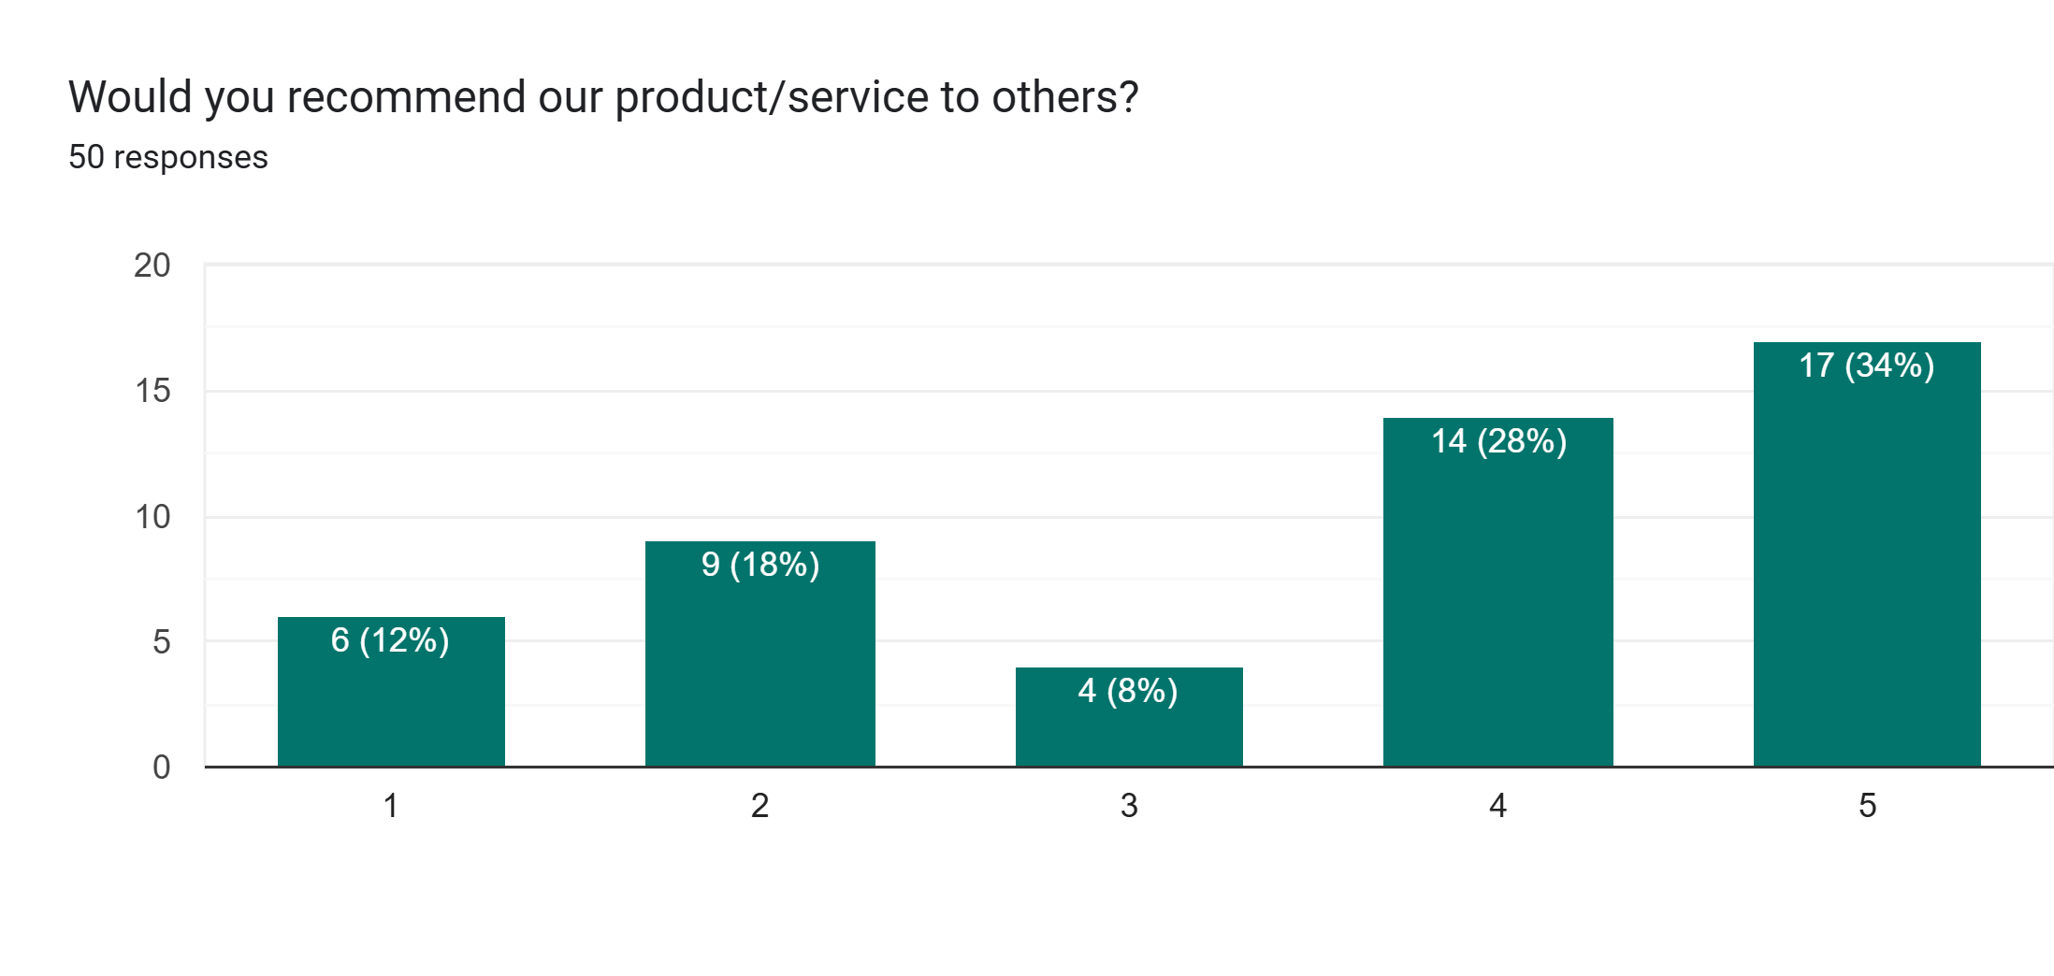
Survey Results

Slide 7
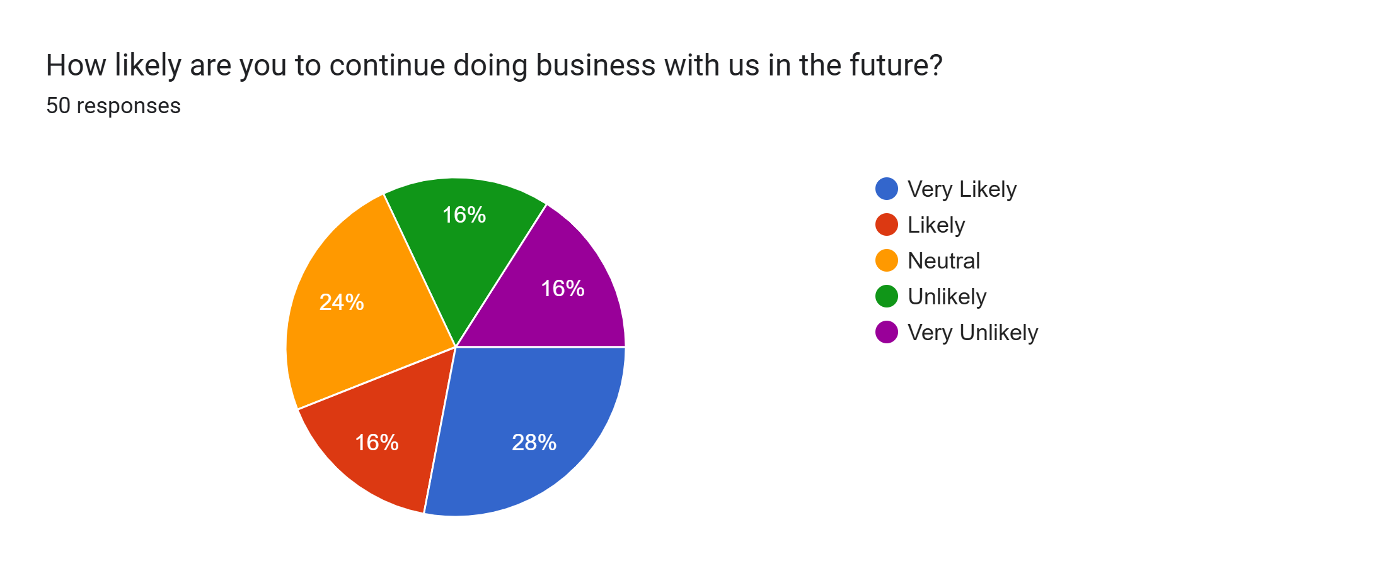
Survey Results

Slide 8
KPI
Customer Satisfaction Rate: Average of 3.2/5 of customers are satisfied
with our products/services.
Net Promoter Score: Average of 3.54/5 of customers would recommend us to others.
Customer Retention Likelihood: 44% of customers plan to continue doing business with us.
Service Resolution Time: 66% of customer issues were resolved quickly.
Value for Money Rating: 54% of customers rated our product/service as "Good" or "Excellent."
Most Product Purchased: The most common suggestion was clothing.
Customer Feedback Response Rate: 100% of customers responded to the survey.

Slide 9


THANK YOU

